Slide 1






Data Aggregation
How to get data insights?
Data Aggregation
SoftUni Team
Technical Trainers
Software University
http://softuni.bg

Slide 2
Grouping
Grouping allows taking data into separate groups based on a common property
Grouping column
employee | department_name | salary
Adam | Database Support | 5,000
John | Database Support | 15,000
Jane | Application Support | 10,000
George | Application Support | 15,000
Lila | Application Support | 5,000
Fred | Software Support | 15,000
Can be aggregated

Slide 3
GROUP BY
With GROUP BY you can get each separate group and use an "aggregate" function over it (like Average, Min or Max):
SELECT e.`job_title`, count(employee_id)
FROM `employees` AS e
GROUP BY e.`job_title`;
Grouping
Columns
Notes:
When we use GROUP BY we can easily achieve distinct values. Grouping leaves only the unique combination of values.
Using the keyword DISTINCT is another way to eliminate the duplicate values. It simplifies the syntax because we don’t have to write down every single column in the GROUP BY part.

Slide 4
DISTINCT
With DISTINCT you will get all unique values:
SELECT DISTINCT e.`job_title` FROM `employees` AS e;
Unique Values
Notes:
When we use GROUP BY we can easily achieve distinct values. Grouping leaves only the unique combination of values.
Using the keyword DISTINCT is another way to eliminate the duplicate values. It simplifies the syntax because we don’t have to write down every single column in the GROUP BY part.

Slide 5
Problem: Departments Total Salaries
Write a query which prints the total sum of salaries for each department in the soft_uni database
Order them by DepartmentID (ascending)
employee | department_name | salary
Adam | Database Support | 5,000
John | Database Support | 15,000
Jane | Application Support | 10,000
George | Application Support | 15,000
Lila | Application Support | 5,000
Fred | Software Support | 15,000
department_id | total_salary
1 | 20,000
2 | 30,000
3 | 15,000
Check your solution here: https://judge.softuni.bg/Contests/Practice/Index/296#18
Notes:
Use grouping to aggregate data. In order to achieve aggregation you need columns that will define the groups. In the case above we will use DepartmentID for aggregation purposes. The column has 3 unique values: “1”, “2” and “3”. Therefore, we will have 3 groups. Moreover, we can sum the salaries of the employees in those departments. If we add the Employee column we will have 6 groups because we have 6 unique combinations of values.

Slide 6
Solution: Departments Total Salaries
Grouping Column
New Column Alias
SELECT e.`department_id`,
SUM(e.`salary`) AS 'Total Salary'
FROM `employees` AS e
GROUP BY e.`department_id`
ORDER BY e.`department_id`;
Table Alias
Grouping Columns
Check your solution here: https://judge.softuni.bg/Contests/Practice/Index/296#18
Notes:
SQL provides the functionality by the statement GROUP BY. It is mandatory to have all the columns from the SELECT part in the GROUP BY part. On the other hand, it is possible to have columns in GROUP BY part but not in SELECT part. In this case the groups will be the same as if it was in the SELECT part but the missing columns wouldn’t be visualized.

Slide 7

Aggregate Functions
COUNT, SUM, MAX, MIN, AVG…

Slide 8
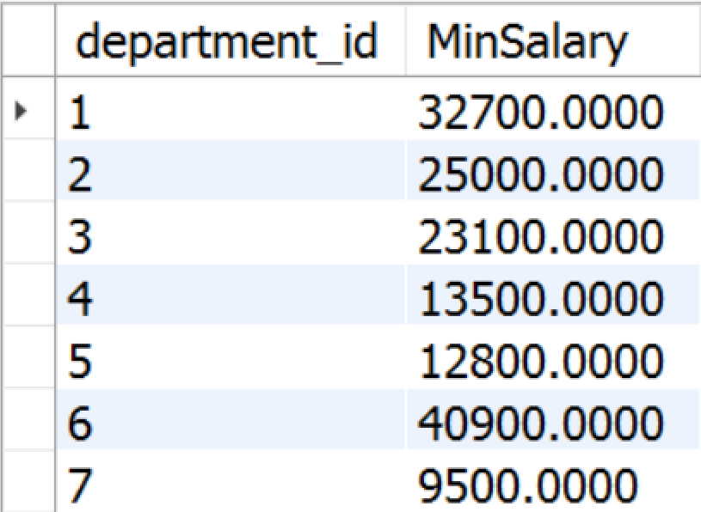
Aggregate Functions
Used to operate over one or more groups performing data analysis on every one
MIN, MAX, AVG, COUNT etc.
They usually ignore NULL values
SELECT e.`department_id`,
MIN(e.`salary`) AS 'MinSalary'
FROM `employees` AS e
GROUP BY e.`department_id`;

Slide 9
COUNT
COUNT - counts the values (not nulls) in one or more columns based on grouping criteria
employee | department_name | salary
Adam | Database Support | 5,000
John | Database Support | 15,000
Jane | Application Support | 10,000
George | Application Support | 15,000
Lila | Application Support | 5,000
Fred | Software Support | 15,000
department_name | SalaryCount
Database Support | 2
Application Support | 3
Software Support | 1
Notes:
If any of the values are NULL they are ignored. For example, if one the values is NULL and the other is 5,000 the COUNT will return 1 because it will ignore the NULL value. On the other hand, we can count everything by writing COUNT(*).

Slide 10
COUNT Syntax
Note that we when we use COUNT we will ignore any employee with NULL salary.
Grouping Column
New Column Alias
SELECT e.`department_id`,
COUNT(e.`salary`) AS 'Salary Count'
FROM `employees` AS e
GROUP BY e.`department_id`;
Grouping Columns

Slide 11
SUM
SUM - sums the values in a column
employee | department_name | salary
Adam | Database Support | 5,000
John | Database Support | 15,000
Jane | Application Support | 10,000
George | Application Support | 15,000
Lila | Application Support | 5,000
Fred | Software Support | 15,000
department_name | total_salary
Database Support | 20,000
Application Support | 30,000
Software Support | 15,000

Slide 12
SUM Syntax
If any department has no salaries NULL will be displayed.
Grouping Column
New Column Alias
SELECT e.`department_id`, SUM(e.`salary`) AS 'TotalSalary'
FROM `employees` AS e
GROUP BY e.`department_id`;
Table Alias
Grouping Columns

Slide 13
MAX
MAX - takes the maximum value in a column.
employee | department_name | salary
Adam | Database Support | 5,000
John | Database Support | 15,000
Jane | Application Support | 10,000
George | Application Support | 15,000
Lila | Application Support | 5,000
Fred | Software Support | 15,000
department_name | max_salary
Database Support | 20,000
Application Support | 30,000
Software Support | 15,000
Notes:
NULLs are ignored again.

Slide 14
MAX Syntax
Grouping Column
SELECT e.`department_id`, MAX(e.`salary`) AS 'MaxSalary'
FROM `employees` AS e
GROUP BY e.`department_id`;
New Column Alias
Table Alias
Grouping Columns

Slide 15
MIN
MIN takes the minimum value in a column.
employee | department_name | salary
Adam | Database Support | 5,000
John | Database Support | 15,000
Jane | Application Support | 10,000
George | Application Support | 15,000
Lila | Application Support | 5,000
Fred | Software Support | 15,000
department_name | min_salary
Database Support | 5,000
Application Support | 5,000
Software Support | 15,000

Slide 16
MIN Syntax
Grouping Column
SELECT e.`department_id`, MIN(e.`salary`) AS 'MinSalary'
FROM `employees` AS e
GROUP BY e.`department_id`;
New Column Alias
Table Alias
Grouping Columns

Slide 17
AVG
AVG calculates the average value in a column.
employee | department_name | salary
Adam | Database Support | 5,000
John | Database Support | 15,000
Jane | Application Support | 10,000
George | Application Support | 15,000
Lila | Application Support | 5,000
Fred | Software Support | 15,000
department_name | average_salary
Database Support | 10,000
Application Support | 10,000
Software Support | 15,000

Slide 18
Demo: AVG Syntax
Grouping Column
New Column Alias
SELECT e.`department_id`,
AVG(e.`salary`) AS 'AvgSalary'
FROM `employees` AS e
GROUP BY e.`department_id`;
Table Alias
Grouping Columns

Slide 19
Having
Using predicates while grouping
Notes:
The HAVING clause is used to filter data based on aggregate values. This means that we cannot use it without grouping before that. Unlike HAVING, the WHERE clause filters rows before the aggregation happens.

Slide 20
Having Clause
The HAVING clause is used to filter data based on aggregate values.
We cannot use it without grouping before that
Any Aggregate functions in the "HAVING" clause and in the "SELECT" statement are executed one time only
Unlike HAVING, the WHERE clause filters rows before the aggregation

Slide 21
Having Clause: Example
Filter departments which have total salary more or equal 15,000.
Aggregated value
employee | department_name | salary | Total Salary
Adam | Database Support | 5,000 | 20,000
John | Database Support | 15,000
Jane | Application Support | 10,000 | 10,000
George | Application Support | 15,000
Lila | Application Support | 5,000
Fred | Software Support | 15,000 | 15,000
department_name | average_salary
Database Support | 10,000
Software Support | 15,000

Slide 22
HAVING Syntax
Aggregate Function
Grouping Column
SELECT e.`department_id`, SUM(e.salary) AS 'TotalSalary'
FROM `employees` AS e
GROUP BY e.`department_id`
HAVING `TotalSalary`< 250000;
New Column Alias
Grouping Columns
Having Predicate

Slide 23


Summary
Grouping
Aggregate Functions
Having
SELECT
SUM(e.`salary) AS 'TotalSalary'
FROM `employees` AS e
GROUP BY e.`department_id`
HAVING SUM(e.`salary`) < 250000;
Databases

